Slide 1
Fair Use Notice
The material used in this presentation i.e., pictures/graphs/text, etc. is solely intended for educational/teaching purpose, offered free of cost to the students for use under special circumstances of Online Education due to COVID-19 Lockdown situation and may include copyrighted material - the use of which may not have been specifically authorised by Copyright Owners. Its application constitutes Fair Use of any such copyrighted material as provided in globally accepted law of many countries. The contents of presentations are intended only for the attendees of the class being conducted by the presenter.

Slide 2

TEMPORAL LOGIC
Program Semantics
Notes:
2

Slide 3
Contents
Using temporal logic to represent simple system behaviors
Understand temporal semantics for a basic imperative programming language

Slide 4
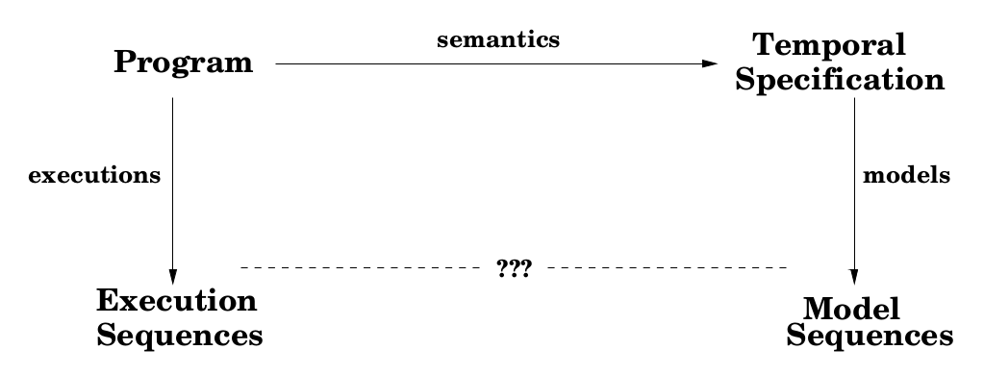
Revision

Slide 5
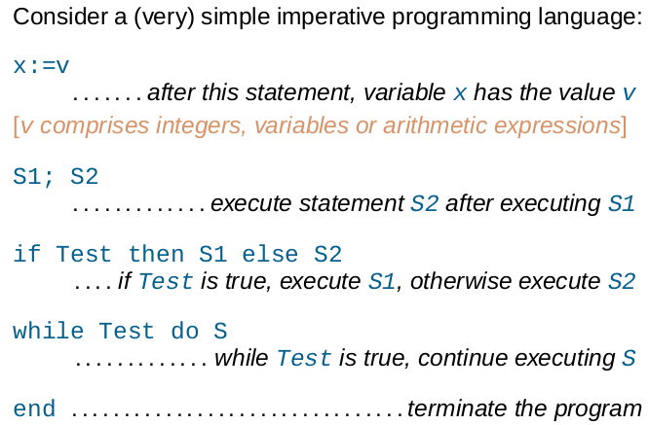
Simple Programming Language
Notes:
5

Slide 6
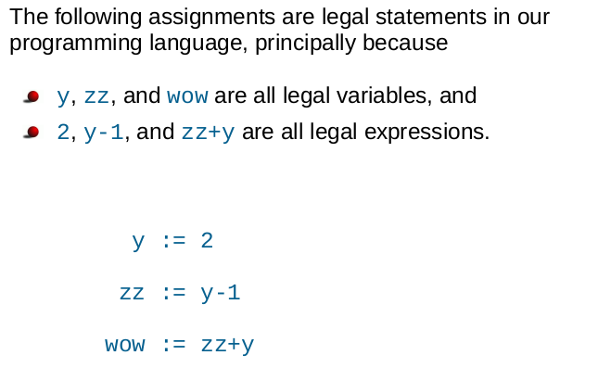
Example Assignments

Slide 7
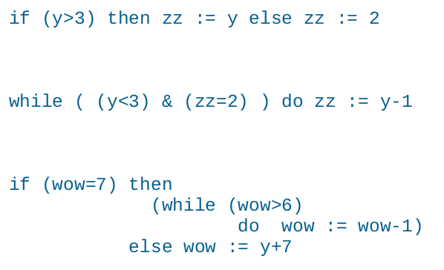
Example Statements

Slide 8
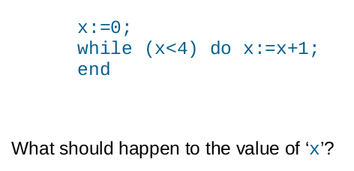
Example Program

Slide 9
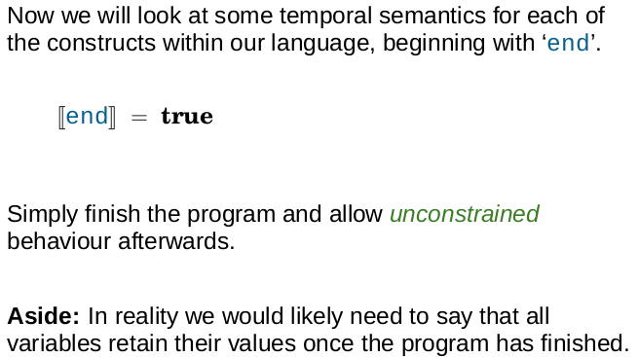
Semantics (end)

Slide 10
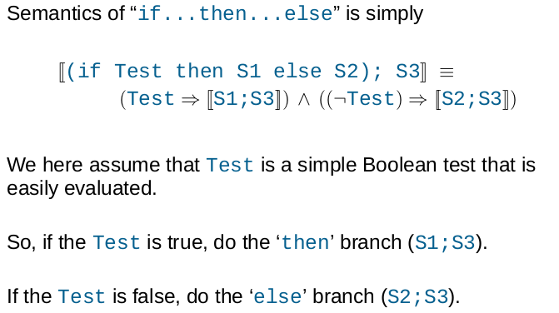
Semantics (If...then...else)

Slide 11
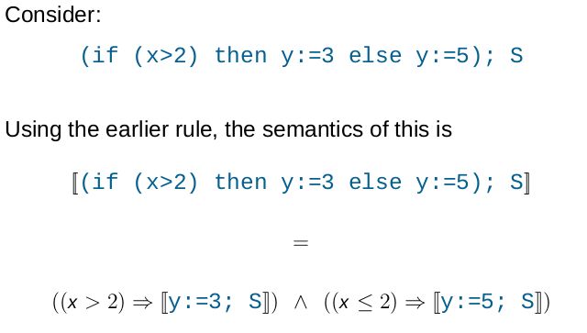
Example - If...then...else

Slide 12
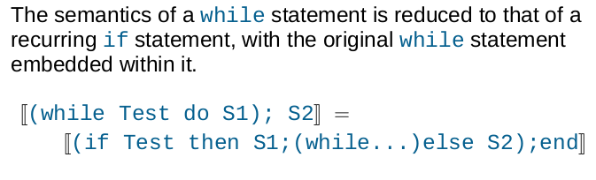
Semantics (while)

Slide 13
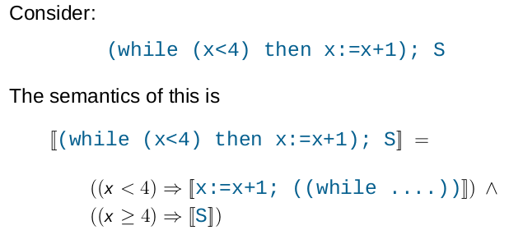
Example - while
Notes:
13

Slide 14
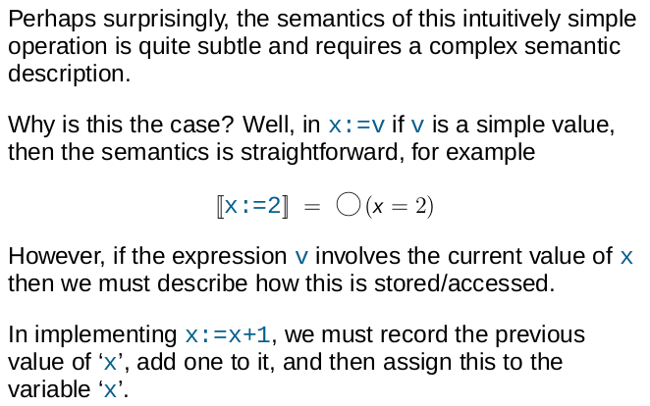
Semantics of Assignment

Slide 15
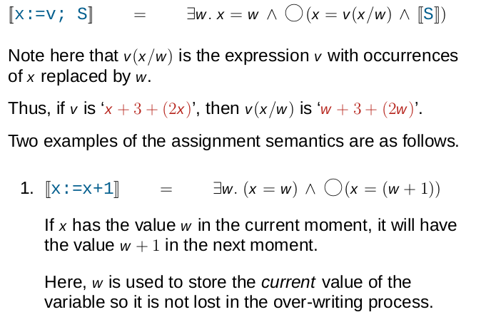
Semantics of Assignment

Slide 16
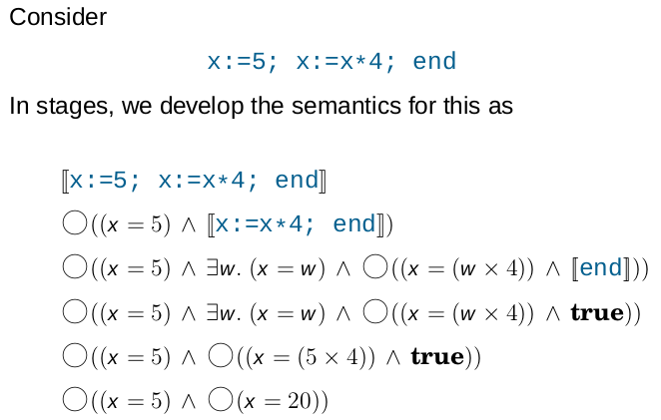
Example - Assignment

Slide 17
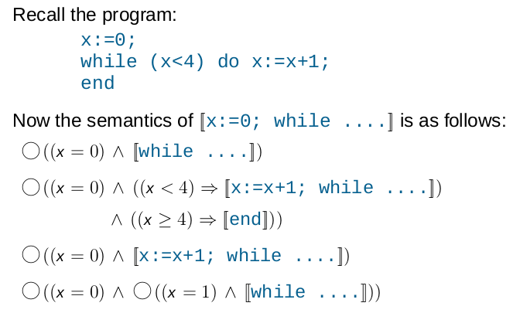
Semantics of Earlier Example

Slide 18
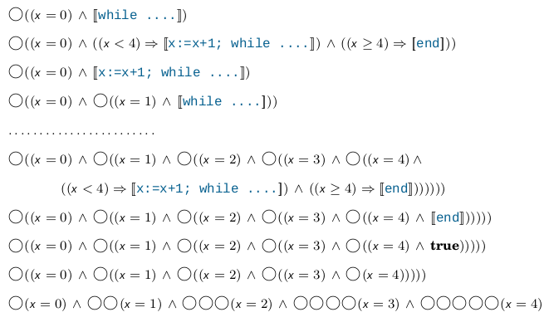
Full Semantic Expansion

Slide 19
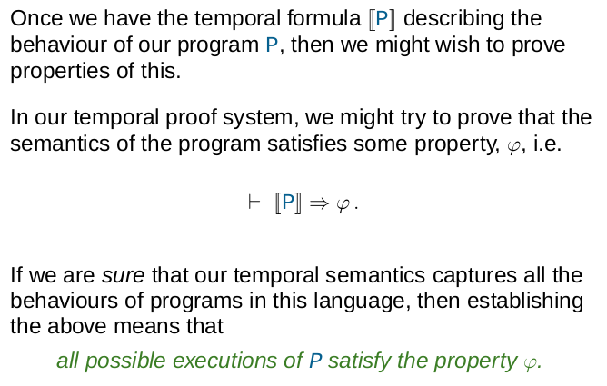
Proving Properties

Slide 20
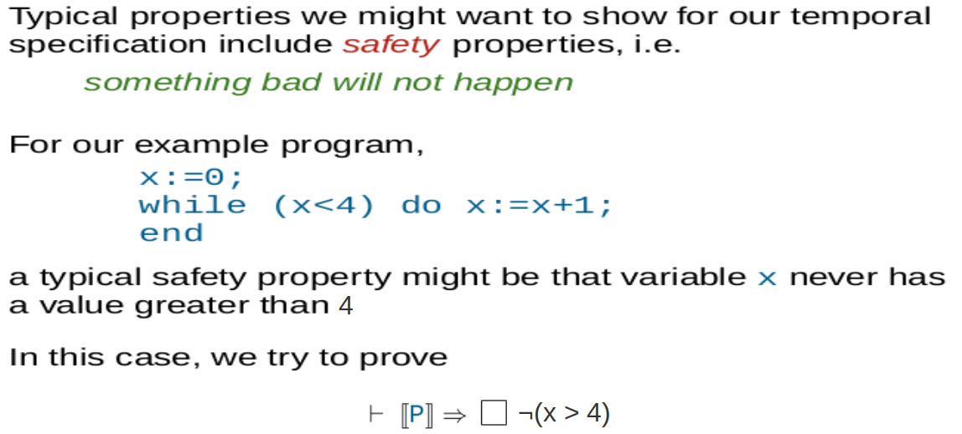

Example - Safety Property

Slide 21
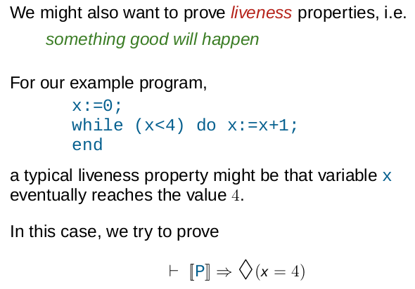
Example - Liveness Property

Slide 22
Exercise
Concerning the temporal semantics of basic imperative programs.
Give a temporal formula characterizing the execution sequences of this program:
z:=3; z:=z+5; z:=z/4; end
Give a temporal formula capturing a semantics of the following statement in a standard imperative programming language:
(if (y>2) then y:=1 else y:=y+2); end
What temporal formula would we write to describe the property that, at some point in the execution of the program in part (b) the variable y is guaranteed to have a value less than 5? Is this a liveness property, a safety property or neither?

Slide 23
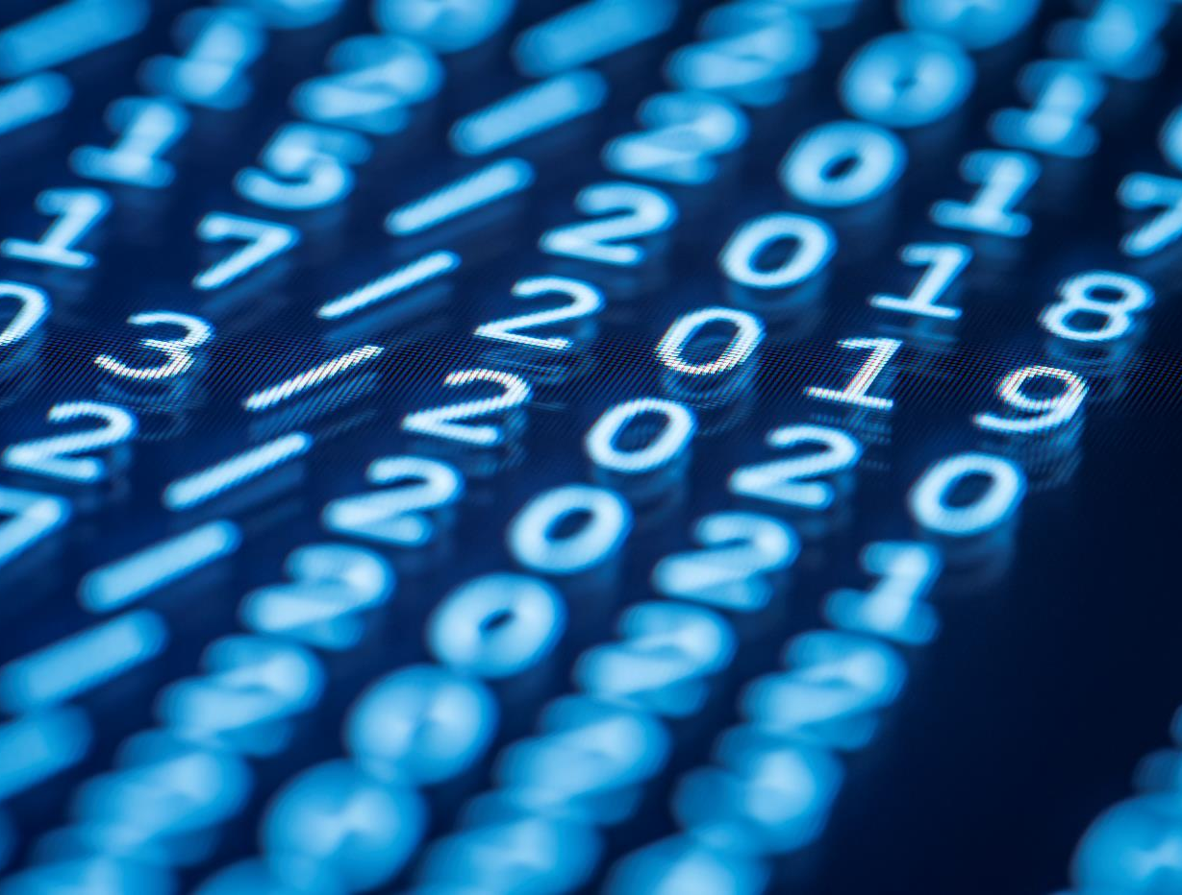
THANK YOU
Notes:
23

